Slide 1

Computer Architecture and Logic Design (CALD) Lecture 03
Engr.Ramsha Mashood
Senior Lecturer
Department of Software Engineering
Bahria University Karachi Campus
Email: sorathhansrajani.bukc@bahria.edu.pk

Slide 2
Moore’s Law
Increased density of components on chip
Gordon Moore – co-founder of Intel
Number of transistors on a chip will double every year
Since 1970’s development has slowed a little
Number of transistors doubles every 18 months
Cost of a chip has remained almost unchanged
Higher packing density means shorter electrical paths, giving higher performance
Smaller size gives increased flexibility
Reduced power and cooling requirements
Fewer interconnections increases reliability

Slide 3
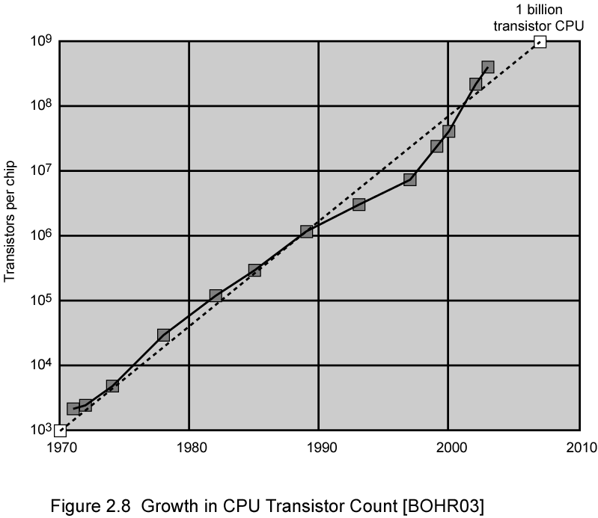
Growth in CPU Transistor Count

Slide 4
Microprocessor Speed
Pipelining:
Multiple stages of operation including fetching the instruction, decoding the opcode, fetching operands, performing a calculation, and so on..
Pipelining enables a processor to work simultaneously on multiple instructions.
For example: while one instruction is being executed, the computer is decoding the next instruction.
Branch prediction:
The processor looks ahead in the instruction code fetched from memory and predicts which branches or group of instructions, are likely to be processed next.
Prefetches the correct instructions and buffer them so that the processor is kept busy.
Superscalar execution:
Ability to issue more than one instruction in every processor clock cycle.
Multiple parallel pipelines are used.

Slide 5
Microprocessor Speed
Data flow analysis:
The processor analyses which instructions are dependent on each other's results, or data, to create an optimized schedule of instructions.
Prevents unnecessary delay.
Speculative execution:
Using branch prediction and data flow analysis, some processors speculatively executes instructions ahead of their actual appearance in the program execution, holding the results in temporary locations.
Enabling processors to keep their execution engines as busy as possible by executing instructions that are likely to be needed.

Slide 6
Performance Balance
While processor speed has grown rapidly, the speed with which data can be transferred between main memory and the processor has lagged badly.
The interface between processor and main memory is the most crucial pathway in the entire computer because it is responsible for carrying a constant flow of program instructions and data between memory chips and the processor.
If memory or the pathway fails to keep pace with the processor’s insistent demands, the processor stalls in a wait state, and valuable processing time is lost

Slide 7
Some Solution
■ Increase the number of bits that are retrieved at one time by making DRAMs “wider” rather than “deeper” and by using wide bus data paths.
■ Change the DRAM interface to make it more efficient by including a cache1 or other buffering scheme on the DRAM chip.
■ Reduce the frequency of memory access by incorporating increasingly complex and efficient cache structures between the processor and main memory. This includes the incorporation of one or more caches on the processor chip as well as on an off-chip cache close to the processor chip.

Slide 8
Continue..
Increase the interconnect bandwidth between processors and memory by using higher-speed buses and a hierarchy of buses to buffer and structure data flow.
Another area of design focus is the handling of I/O devices.

Slide 9
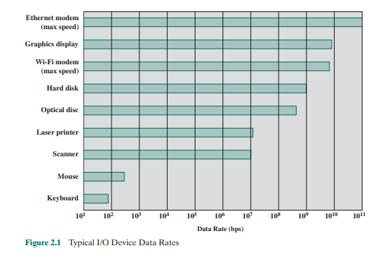
Another area of design focus is the handling of I/O devices.

Slide 10
Improvements in Chip Organization and Architecture
Increase hardware speed of processor
Fundamentally due to shrinking logic gate size
More gates, packed more tightly, increasing clock rate
Propagation time for signals reduced
Increase size and speed of caches
Dedicating part of processor chip
Cache access times drop significantly
Change processor organization and architecture
Increase effective speed of execution
Parallelism

Slide 11
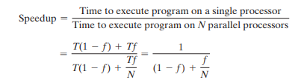
Amdahl’s Law
Amdahl’s law was first proposed by Gene Amdahl in 1967
deals with the potential speedup of a program using multiple processors

Slide 12
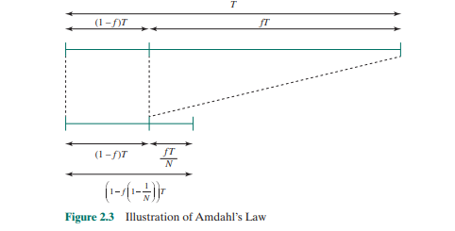
This equation is illustrated in Figures 2.3 and 2.4. Two important conclusions can be drawn:
1. When f is small, the use of parallel processors has little effect.
2. As N approaches infinity, speedup is bound by 1/(1 - f), so that there are diminishing returns for using more processors

Slide 13
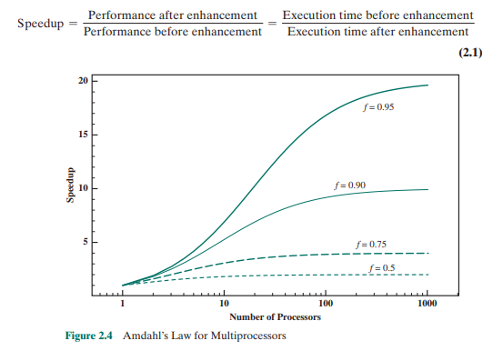
Amdahl’s law can be generalized to evaluate any design or technical improvement in a computer system. Consider any enhancement to a feature of a system that results in a speedup. The speedup can be expressed as

Slide 14

Suppose that a feature of the system is used during execution a fraction of the time f, before enhancement, and that the speedup of that feature after enhancement is SUf. Then the overall speedup of the system is

Slide 15
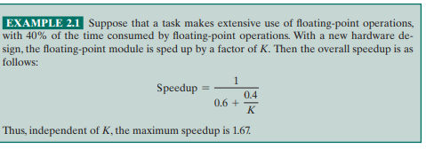
Example 1

Slide 16
Diminishing Returns
Internal organization of processors complex
Can get a great deal of parallelism
Further significant increases likely to be relatively modest
Benefits from cache are reaching limit
Increasing clock rate runs into power dissipation problem
Some fundamental physical limits are being reached

Slide 17
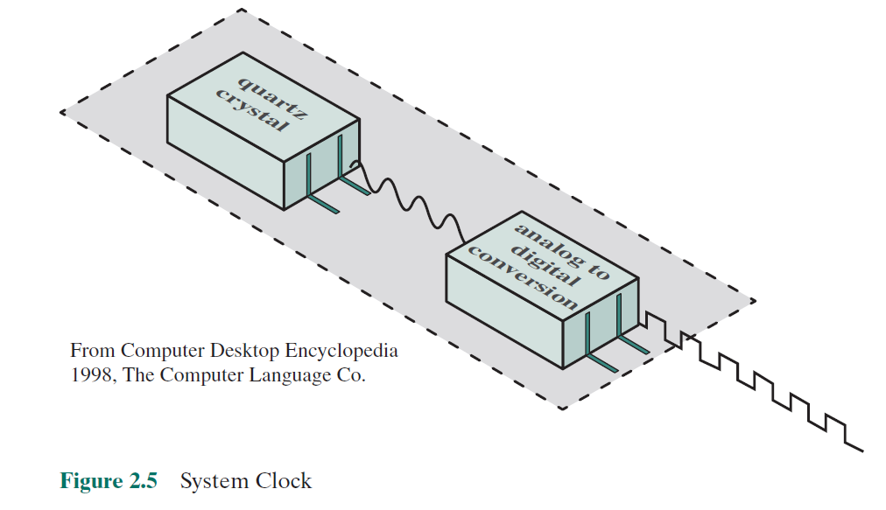
System Clock
Performance is one of the key parameters to consider, along with cost, size, security, reliability, and power consumption (in some cases).
Operations performed by a processor (fetching, decoding, execution), are governed by a system clock.
All operations begin with the pulse of the clock.

Slide 18
Computer Performance Measures – Clock Speed
The execution of an instruction involves a number of discrete steps, such as
Fetching the instruction from memory
Decoding the various portions of the instruction
Loading and storing data
Performing arithmetic and logical operations.

Slide 19
Computer Performance Measures – Clock Speed
Clock rate or clock speed:
Pulse frequency or the rate of pulses produced by the clock.
Measured in number of cycles per second or Hertz (Hz).
Clock cycle or clock tick:
One increment, or pulse of the clock.
Cycle time:
The time between pulses (t = 1/f).

Slide 20
Problems with Clock Speed and Login Density
Power
Power density increases with density of logic and clock speed
Dissipating heat
RC delay
Speed at which electrons flow limited by resistance and capacitance of metal wires connecting them
Delay increases as RC product increases
Wire interconnects thinner, increasing resistance
Wires closer together, increasing capacitance
Memory latency
Memory speeds lag processor speeds
Solution:
More emphasis on organizational and architectural approaches

Slide 21
Computer Performance Measures – Instruction Execution Rate
CPI:
Average number of cycles per instruction.
MIPS:
Millions of Instructions per second.
FLOPS or MFLOPS:
Floating point operations per second or
Millions of floating-point operations per second.

Slide 22

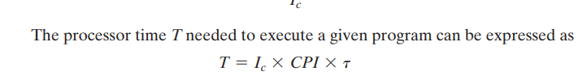
Instruction Execution Rate
Let CPIi be the number of cycles required for instruction type i, and Ii be the number of executed instructions of type i for a given program. Then we can calculate an overall CPI as follows

Slide 23

Instruction Execution Rate
p is the number of processor cycles needed to decode and execute the instruction
m is the number of memory references needed
k is the ratio between memory cycle time and processor cycle time.
The five performance factors in the preceding equation (Ic, p, m, k, t) are influenced by four system attributes: the design of the instruction set (known as instruction set architecture

Slide 24

MIPS RATE
A common measure of performance for a processor is the rate at which instructions are executed, expressed as millions of instructions per second (MIPS), referred to as the MIPS rate. We can express the MIPS rate in terms of the clock rate and CPI as follows

Slide 25
